Slide 1
CSE1142 - Introduction to C Programming
Sanem Arslan Yılmaz
Slides are adapted from:
[1] C How to Program 8th Edition, by Deitel & Deitel.
[2] Problem Solving & Program Design in C, Eighth Edition, R. Hanly & Elliot B. Koffman.

Slide 2
C
A high-level programming language
Developed in 1972 by Dennis Ritchie at AT&T Bell Labs
Designed as language to write the Unix operating system
Resembles everyday English
Very popular

Slide 3
Welcome to C Programming Language
This is the executable code in "machine language."
This is the only thing the computer can understand and run (execute).
We write our programs in "C language" (which is an English-like language)
We use a compiler (such as GCC, Visual C, Borland C, etc.) to translate our program from "C language" to "machine language"
#include <stdio.h>
int main()
{
printf("Hello world!");
return 0;
}
Compile & Link
1110101011001001010001010100101000010010100101010101000101001000100101001
(machine code
or
executable code)
(source code)
(object code)

Slide 4
A Simple C Program: Printing a Line of Text
We begin by considering a simple C program.
Our first example prints a line of text (Fig. 2.1).

Slide 5
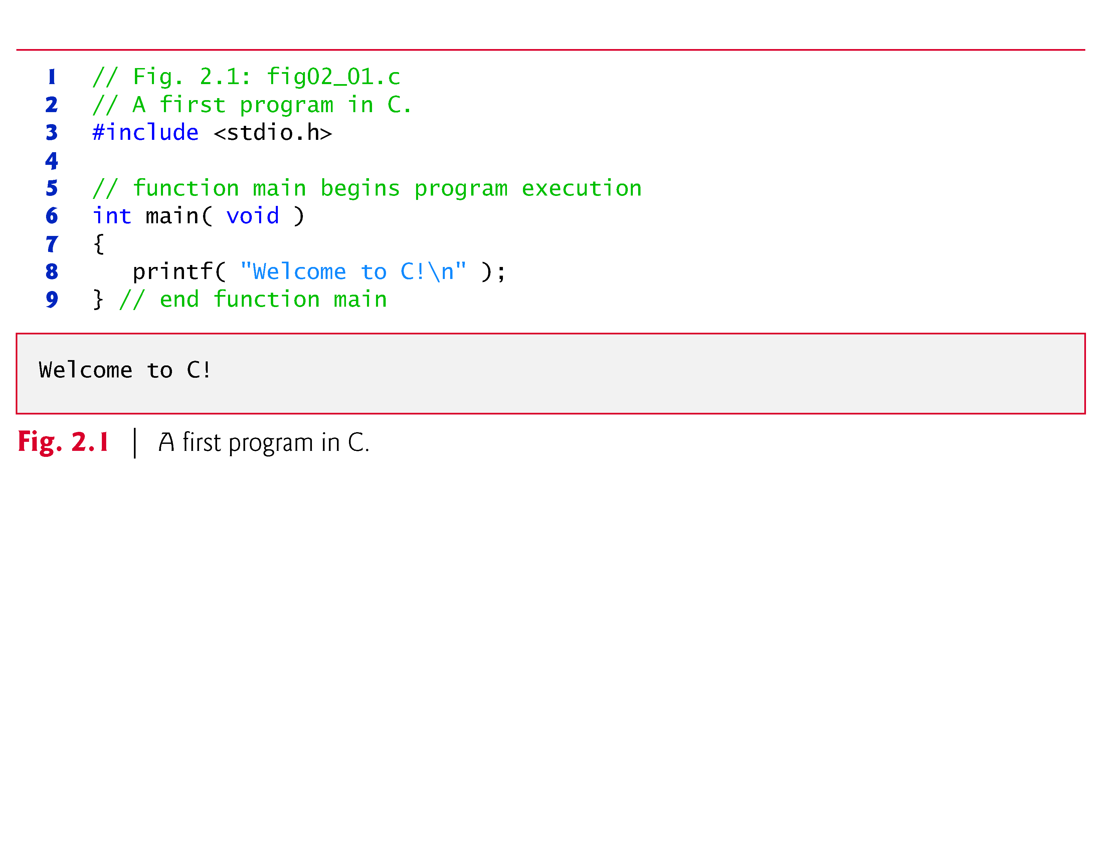
Comments:
  // Fig. 2.1: fig02_01.c
  // A first program in C
  begin with //, indicating that these two lines are comments.
  For multi-line comments, use /*… */.
#include Preprocessor Directive
  #include <stdio.h>
  is a directive to the C preprocessor.
  Tells computer to load contents of a certain file.
  <stdio.h> allows standard input/output operations.
[1] C How to Program 8th Edition, by Deitel & Deitel.

Slide 6
2.2 A Simple C Program:
Printing a Line of Text (Cont.)
The main Function
int main( void )
  is a part of every C program.
  The parentheses after main indicate that main is a program building block called a function.
  C programs contain one or more functions, exactly one of which must be main
  Parenthesis used to indicate a function
  int means that main "returns" an integer value
  Braces { } indicate a block
    The bodies of all functions must be contained in braces
  The void in parentheses here means that main does not receive any information.

Slide 7
2.2 A Simple C Program:
Printing a Line of Text (Cont.)
An Output Statement
printf( "Welcome to C!\n" );
  instructs the computer to perform an action,
    print on the screen the string of characters marked by the quotation marks(“ “).
  Escape character (\)
    Indicates that printf should do something out of the ordinary
    Notice that the characters \n were not printed on the screen.
    \n is the newline character
return 0;
  A way to exit a function
  return 0, in this case, means that the program terminated normally

Slide 8
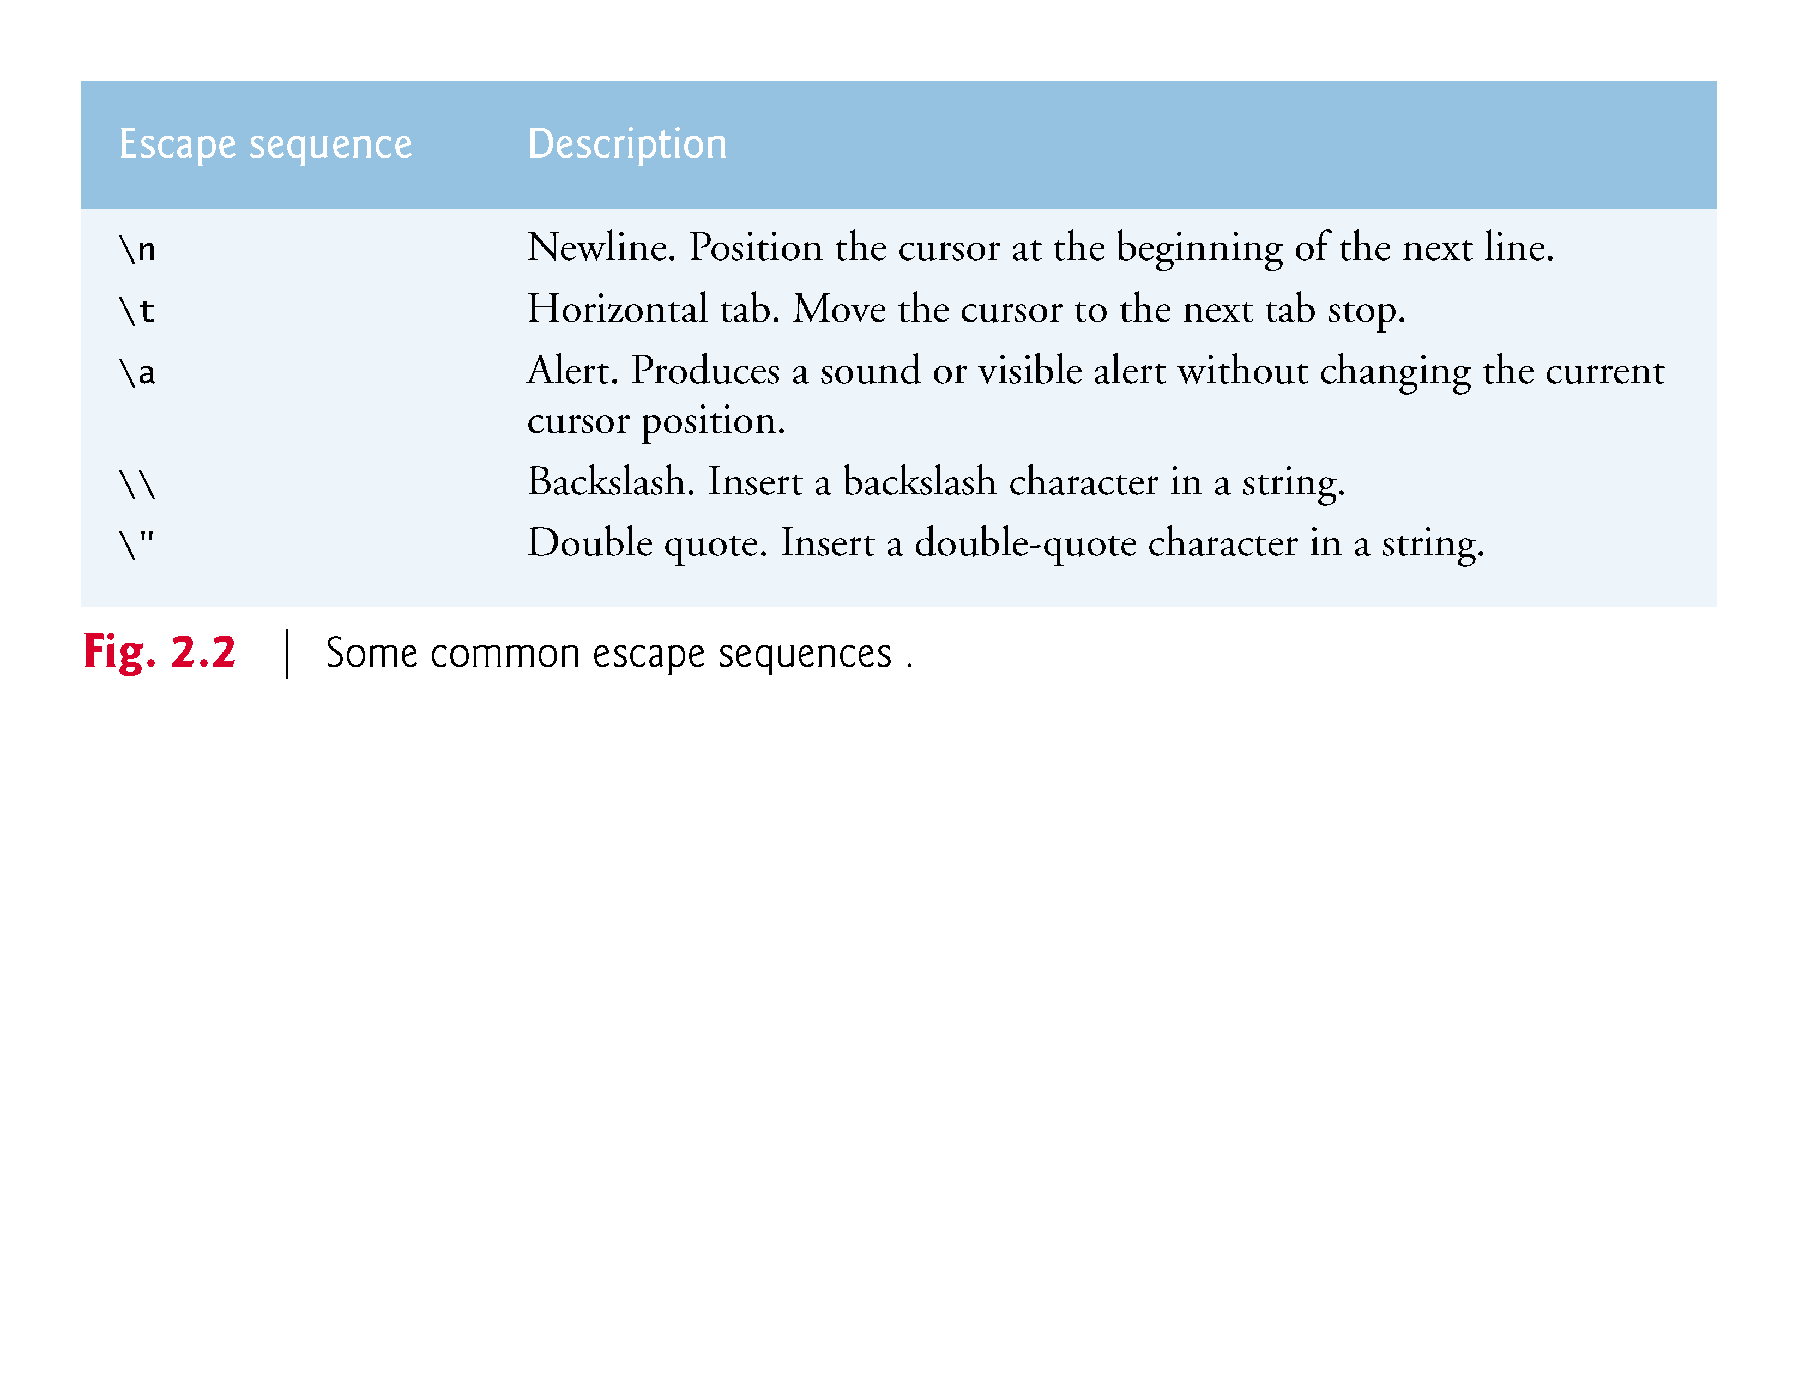

Slide 9
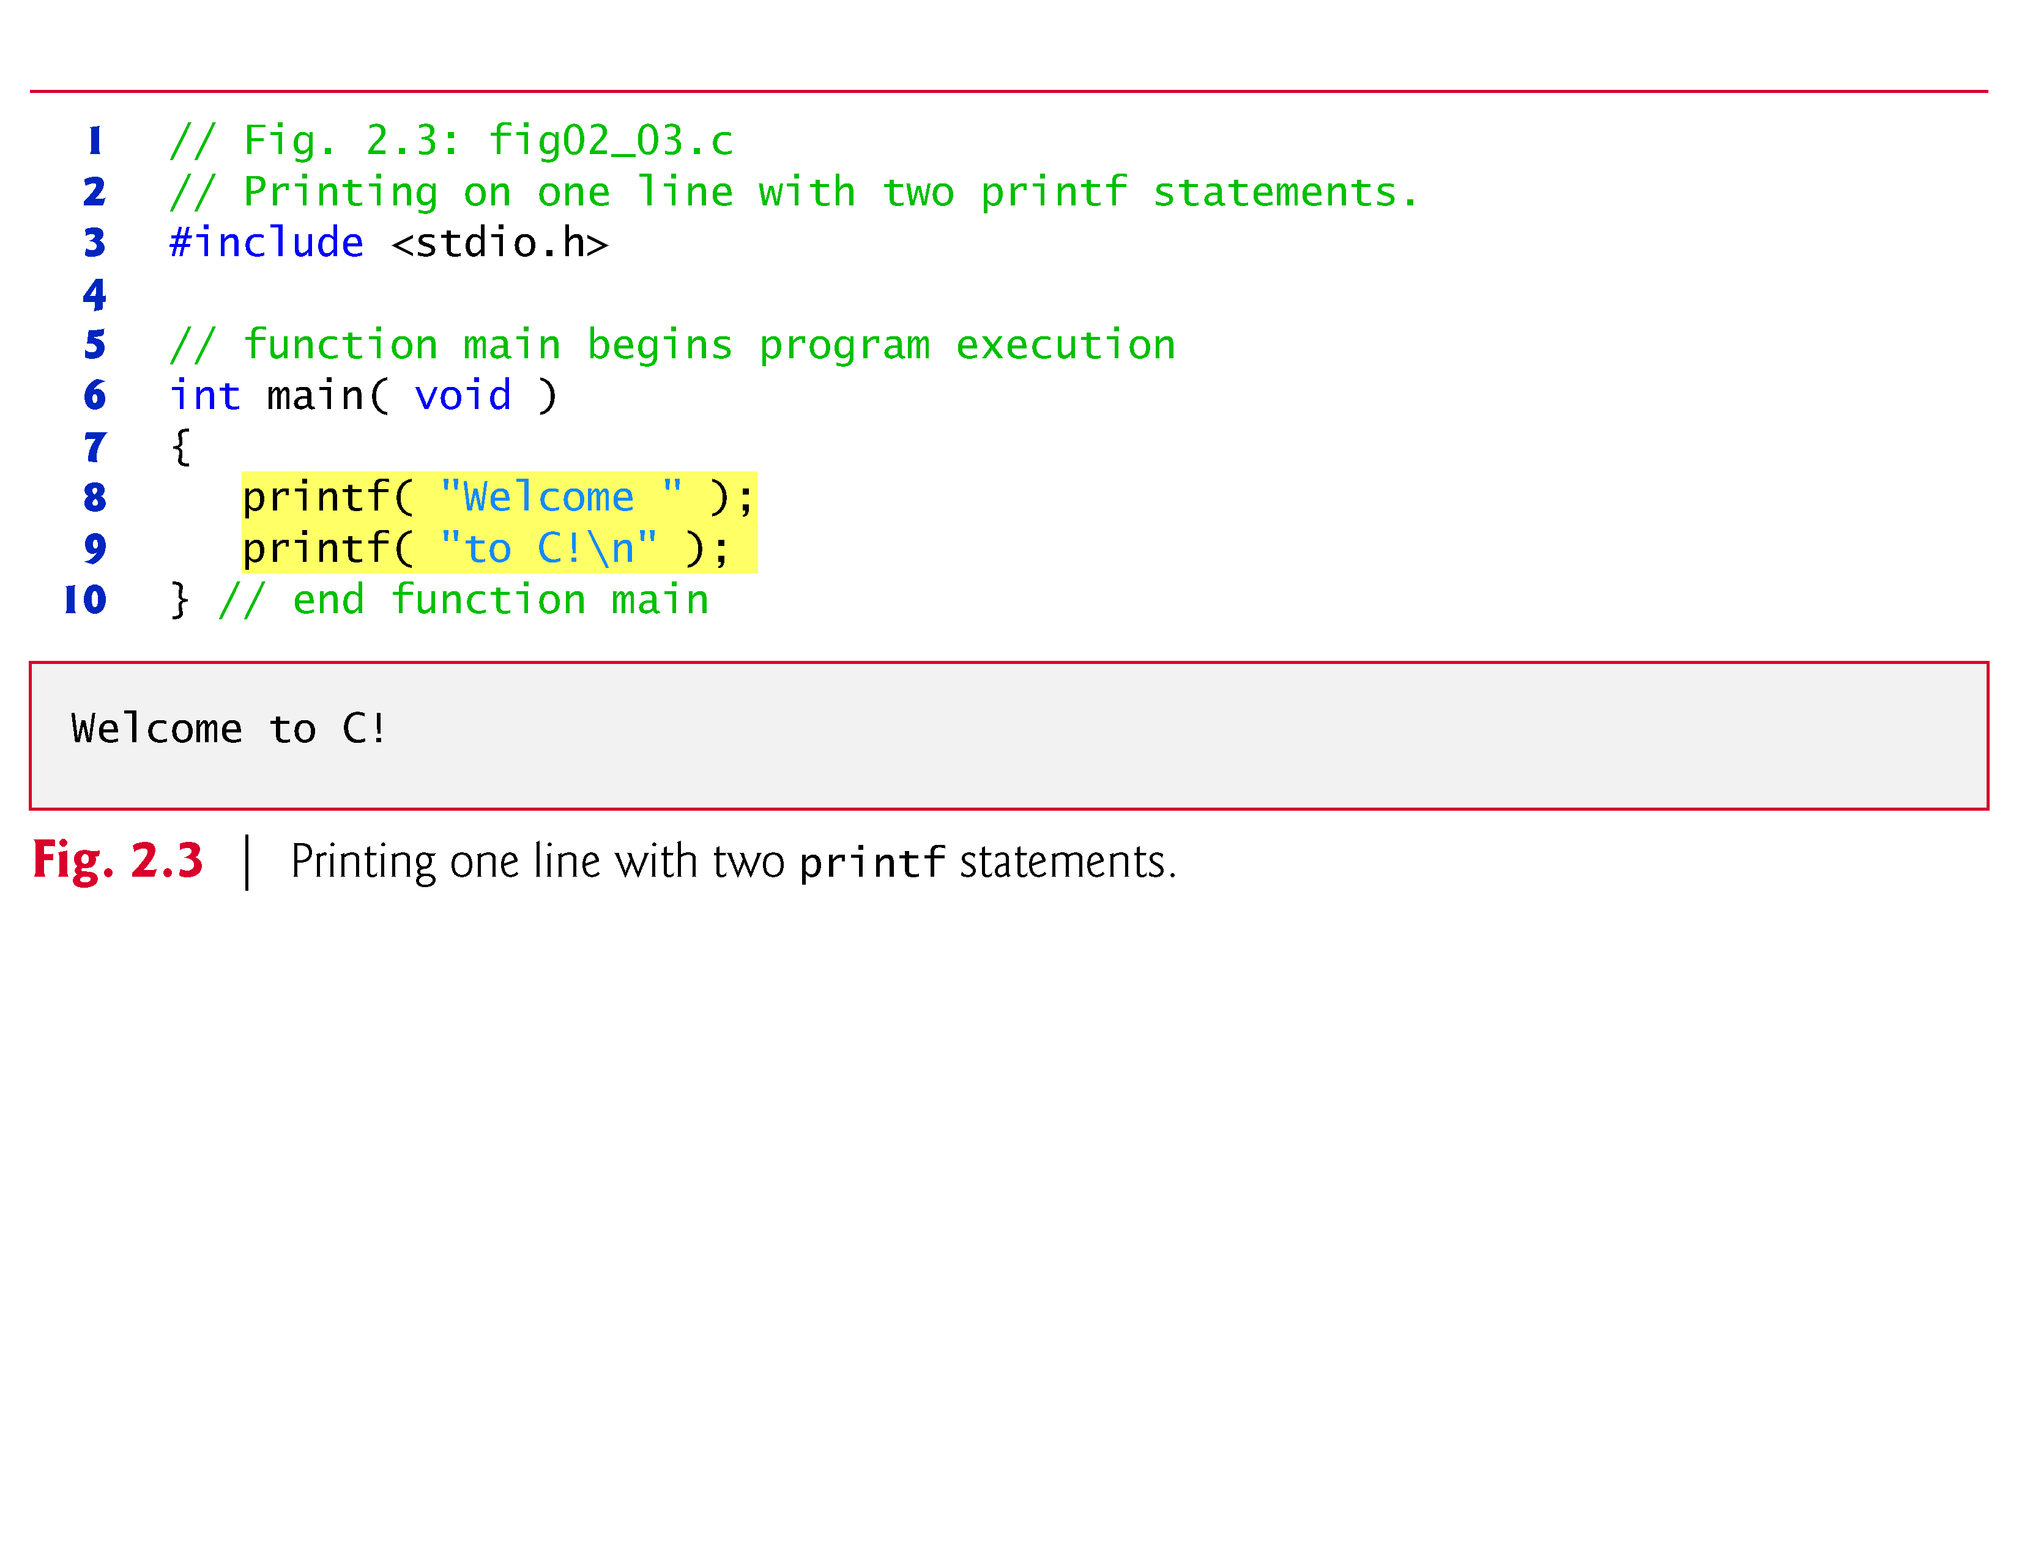
[1] C How to Program 8th Edition, by Deitel & Deitel.

Slide 10
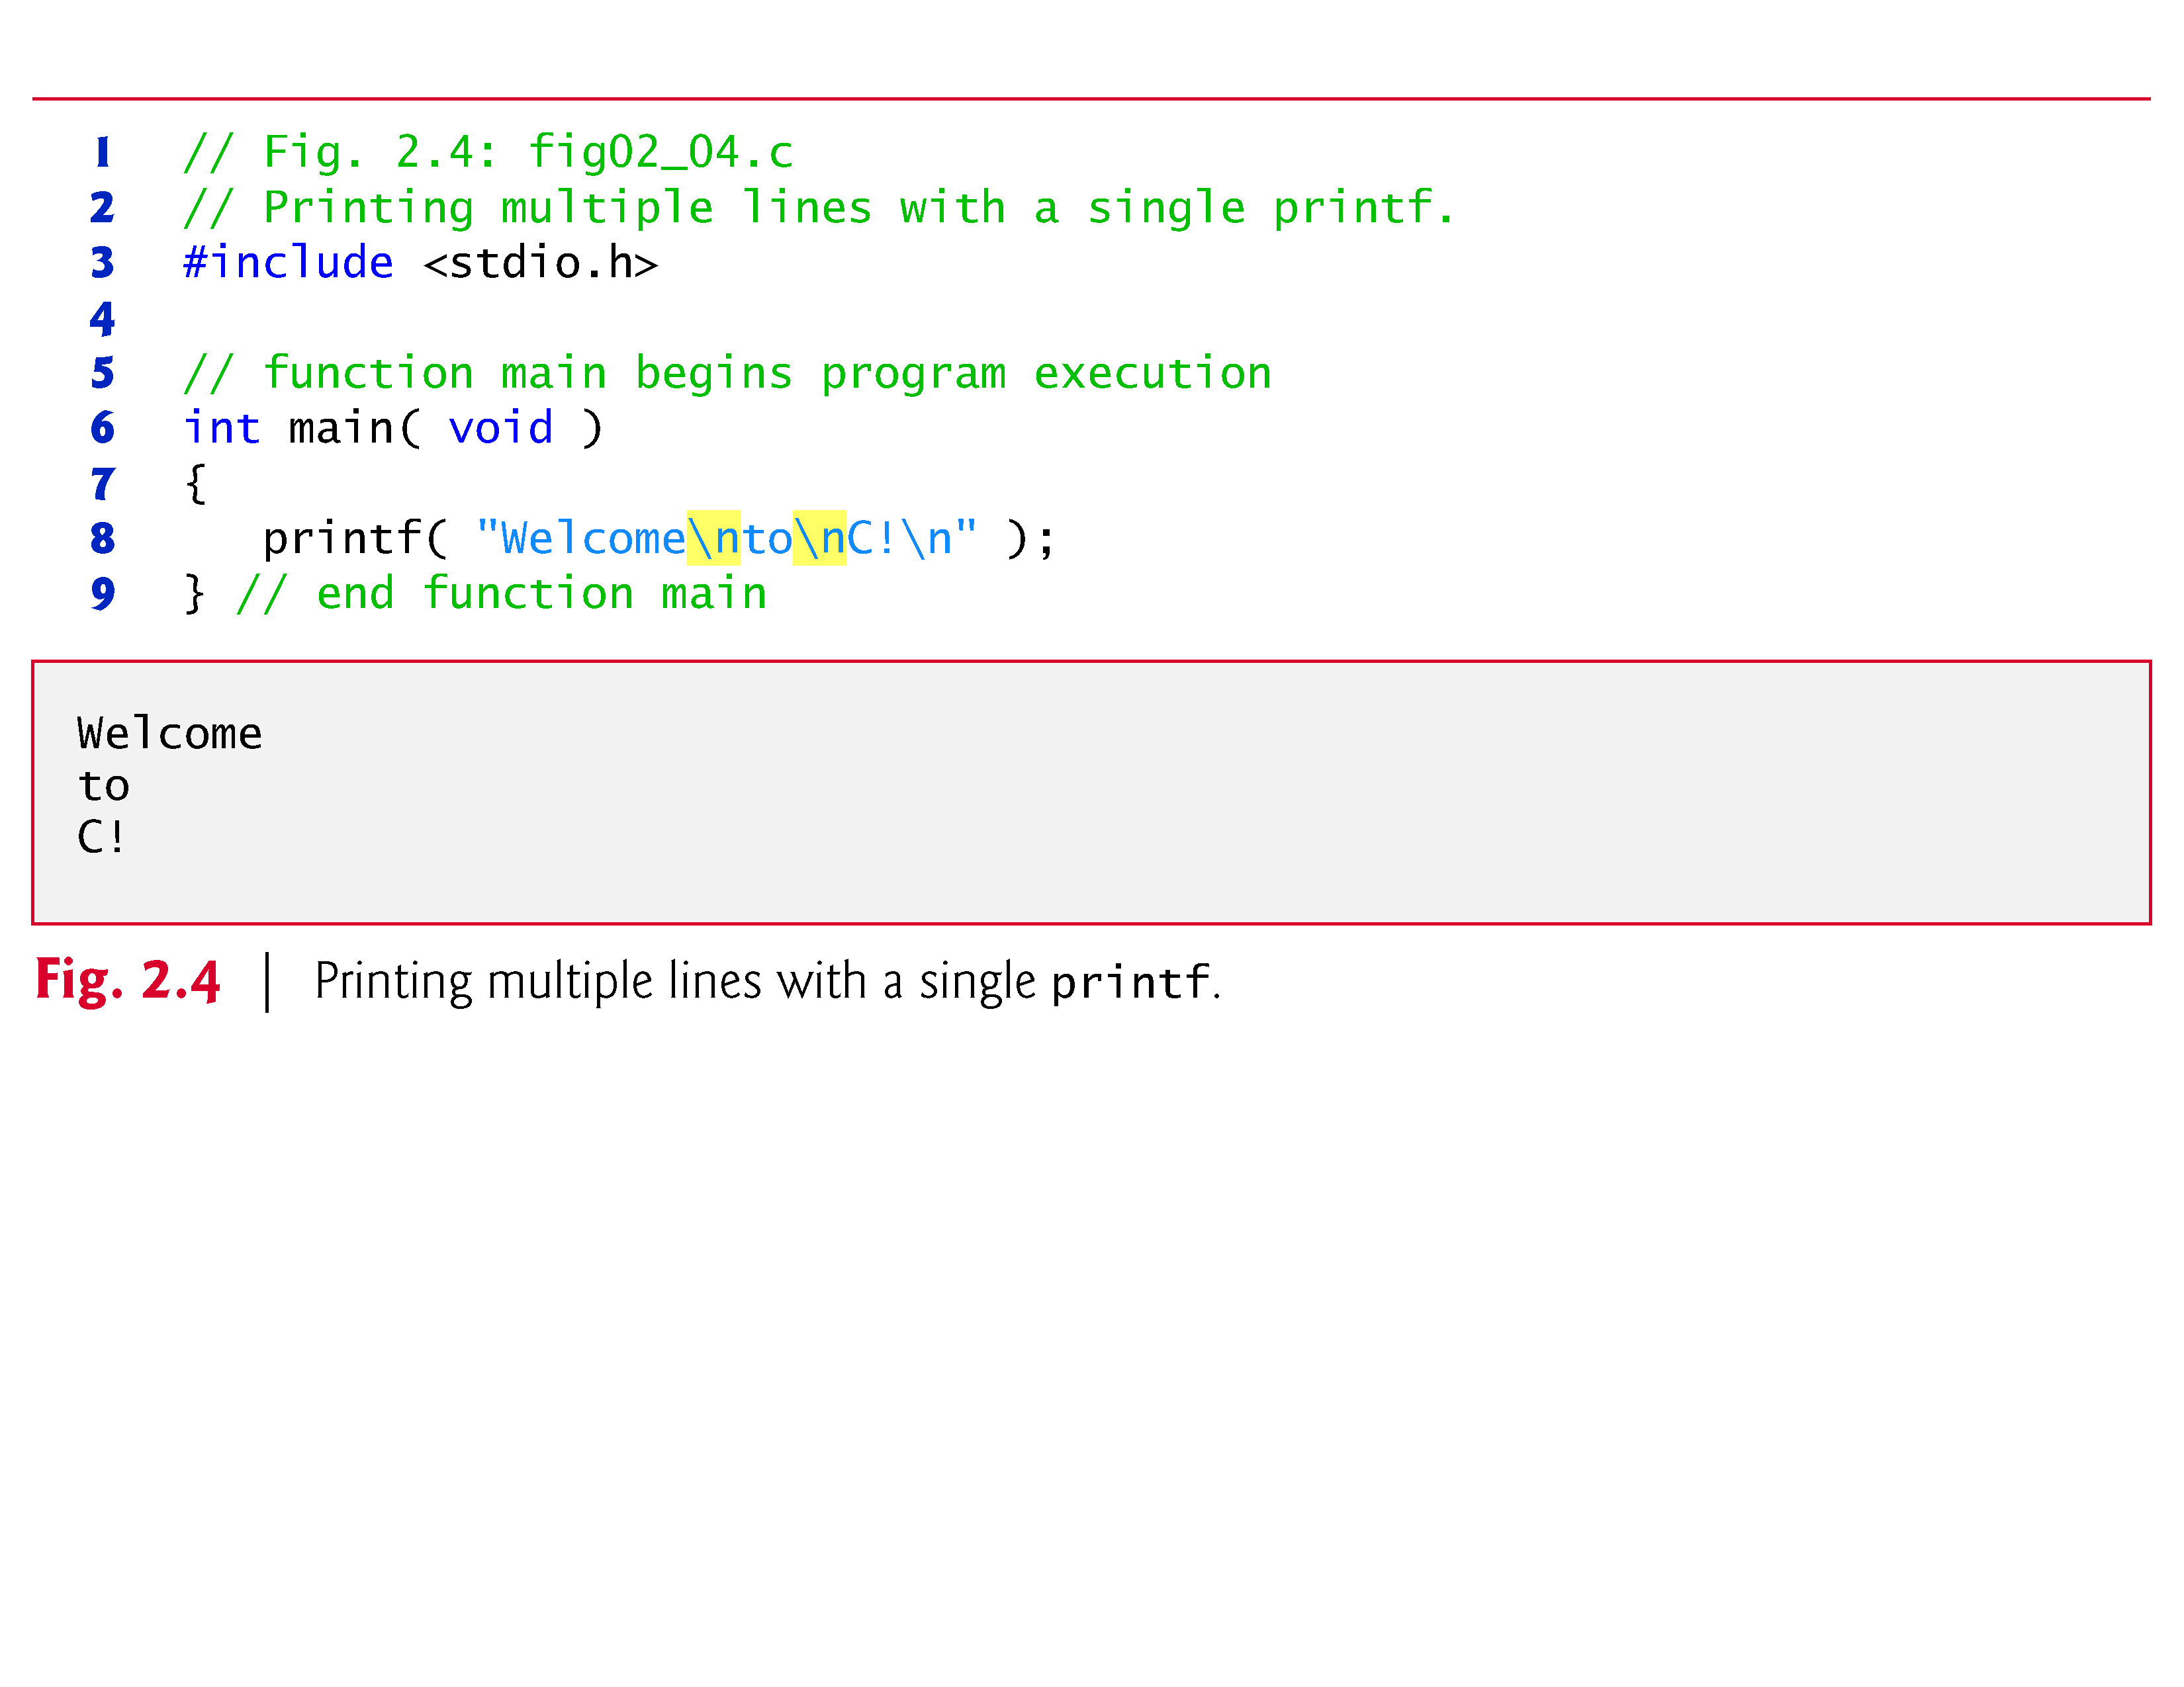
[1] C How to Program 8th Edition, by Deitel & Deitel.

Slide 11
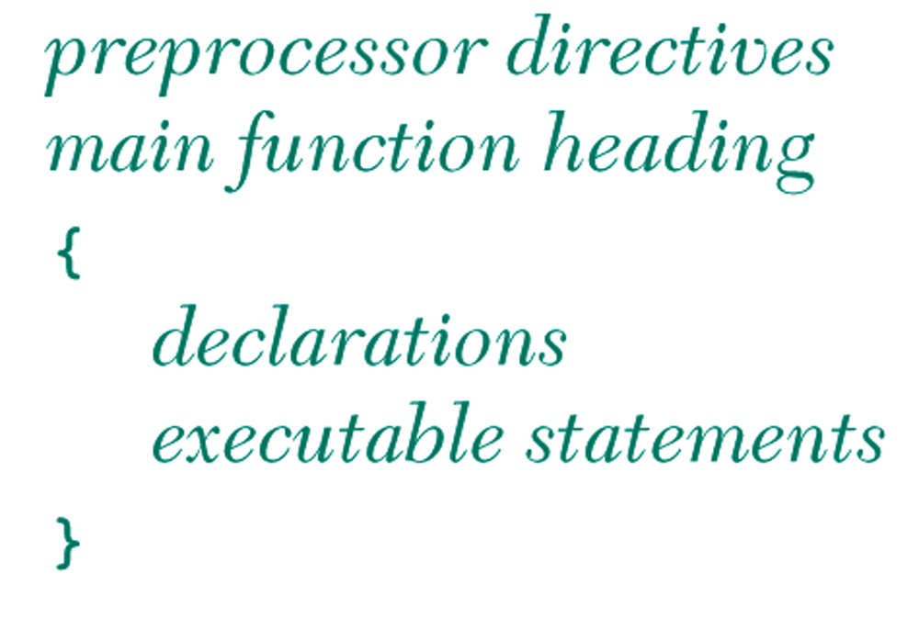
General Form of a C Program

Slide 12
2.3 Another Simple C Program: Adding Two Integers
Our next program (fig. 2.5)
  uses the Standard Library function scanf to obtain two integers typed by a user at the keyboard,
  computes the sum of these values and
  prints the result using printf.

Slide 13
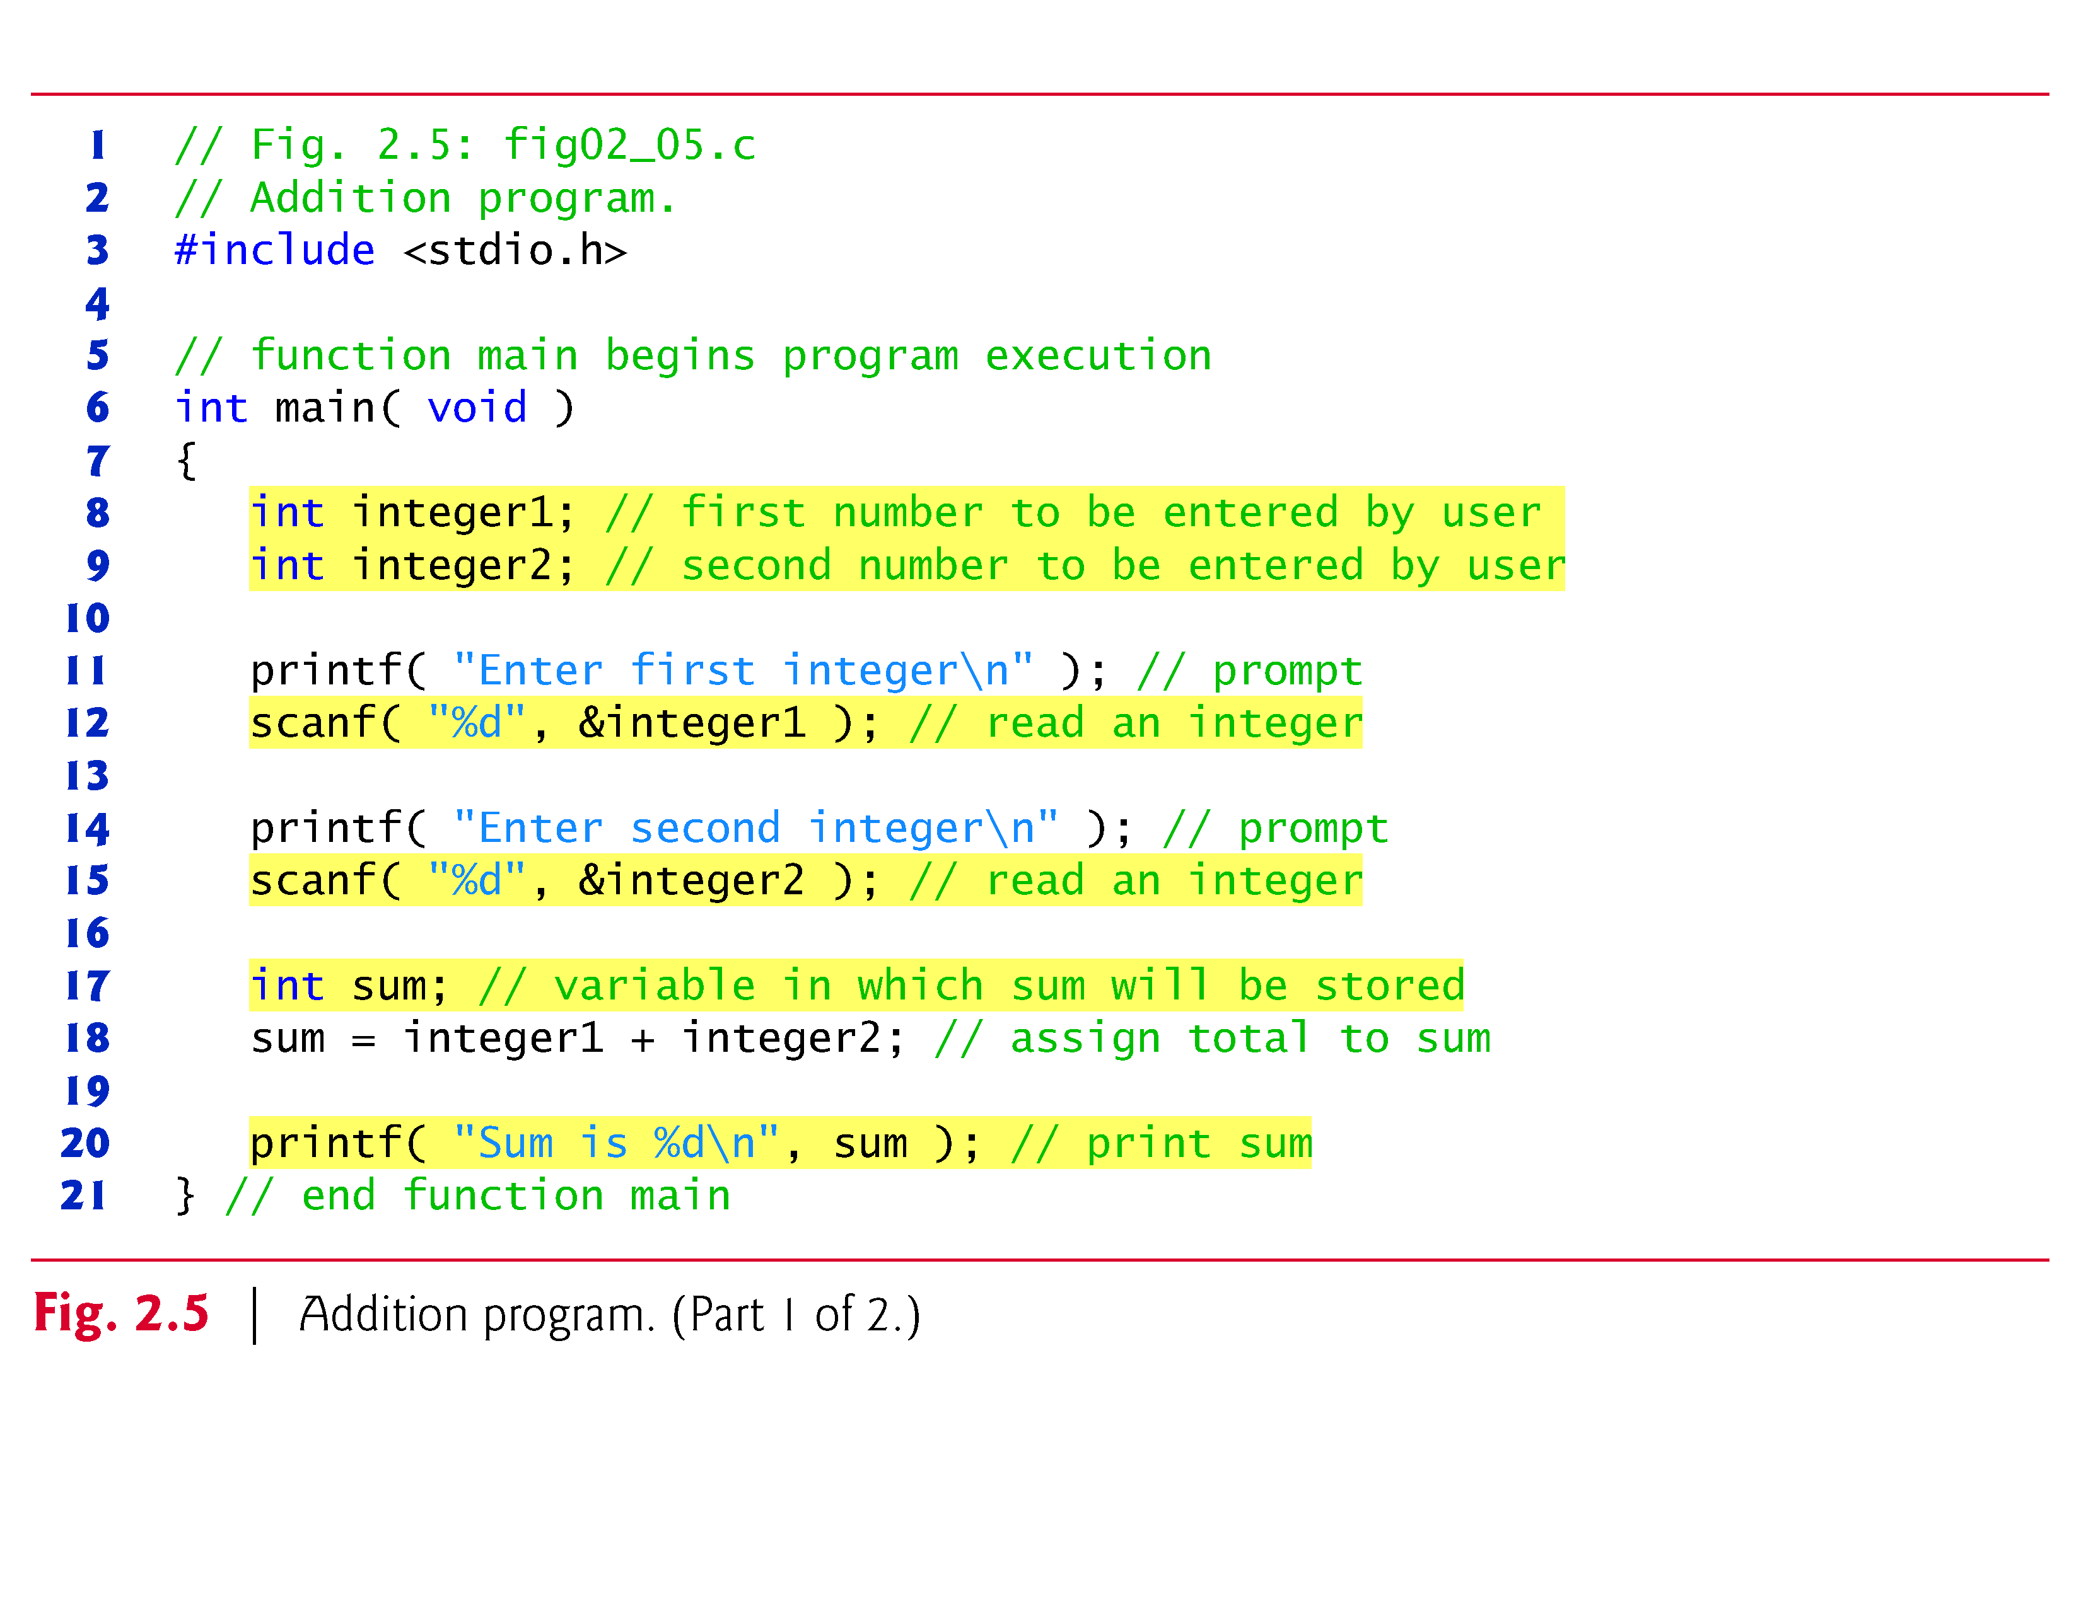
[1] C How to Program 8th Edition, by Deitel & Deitel.

Slide 14
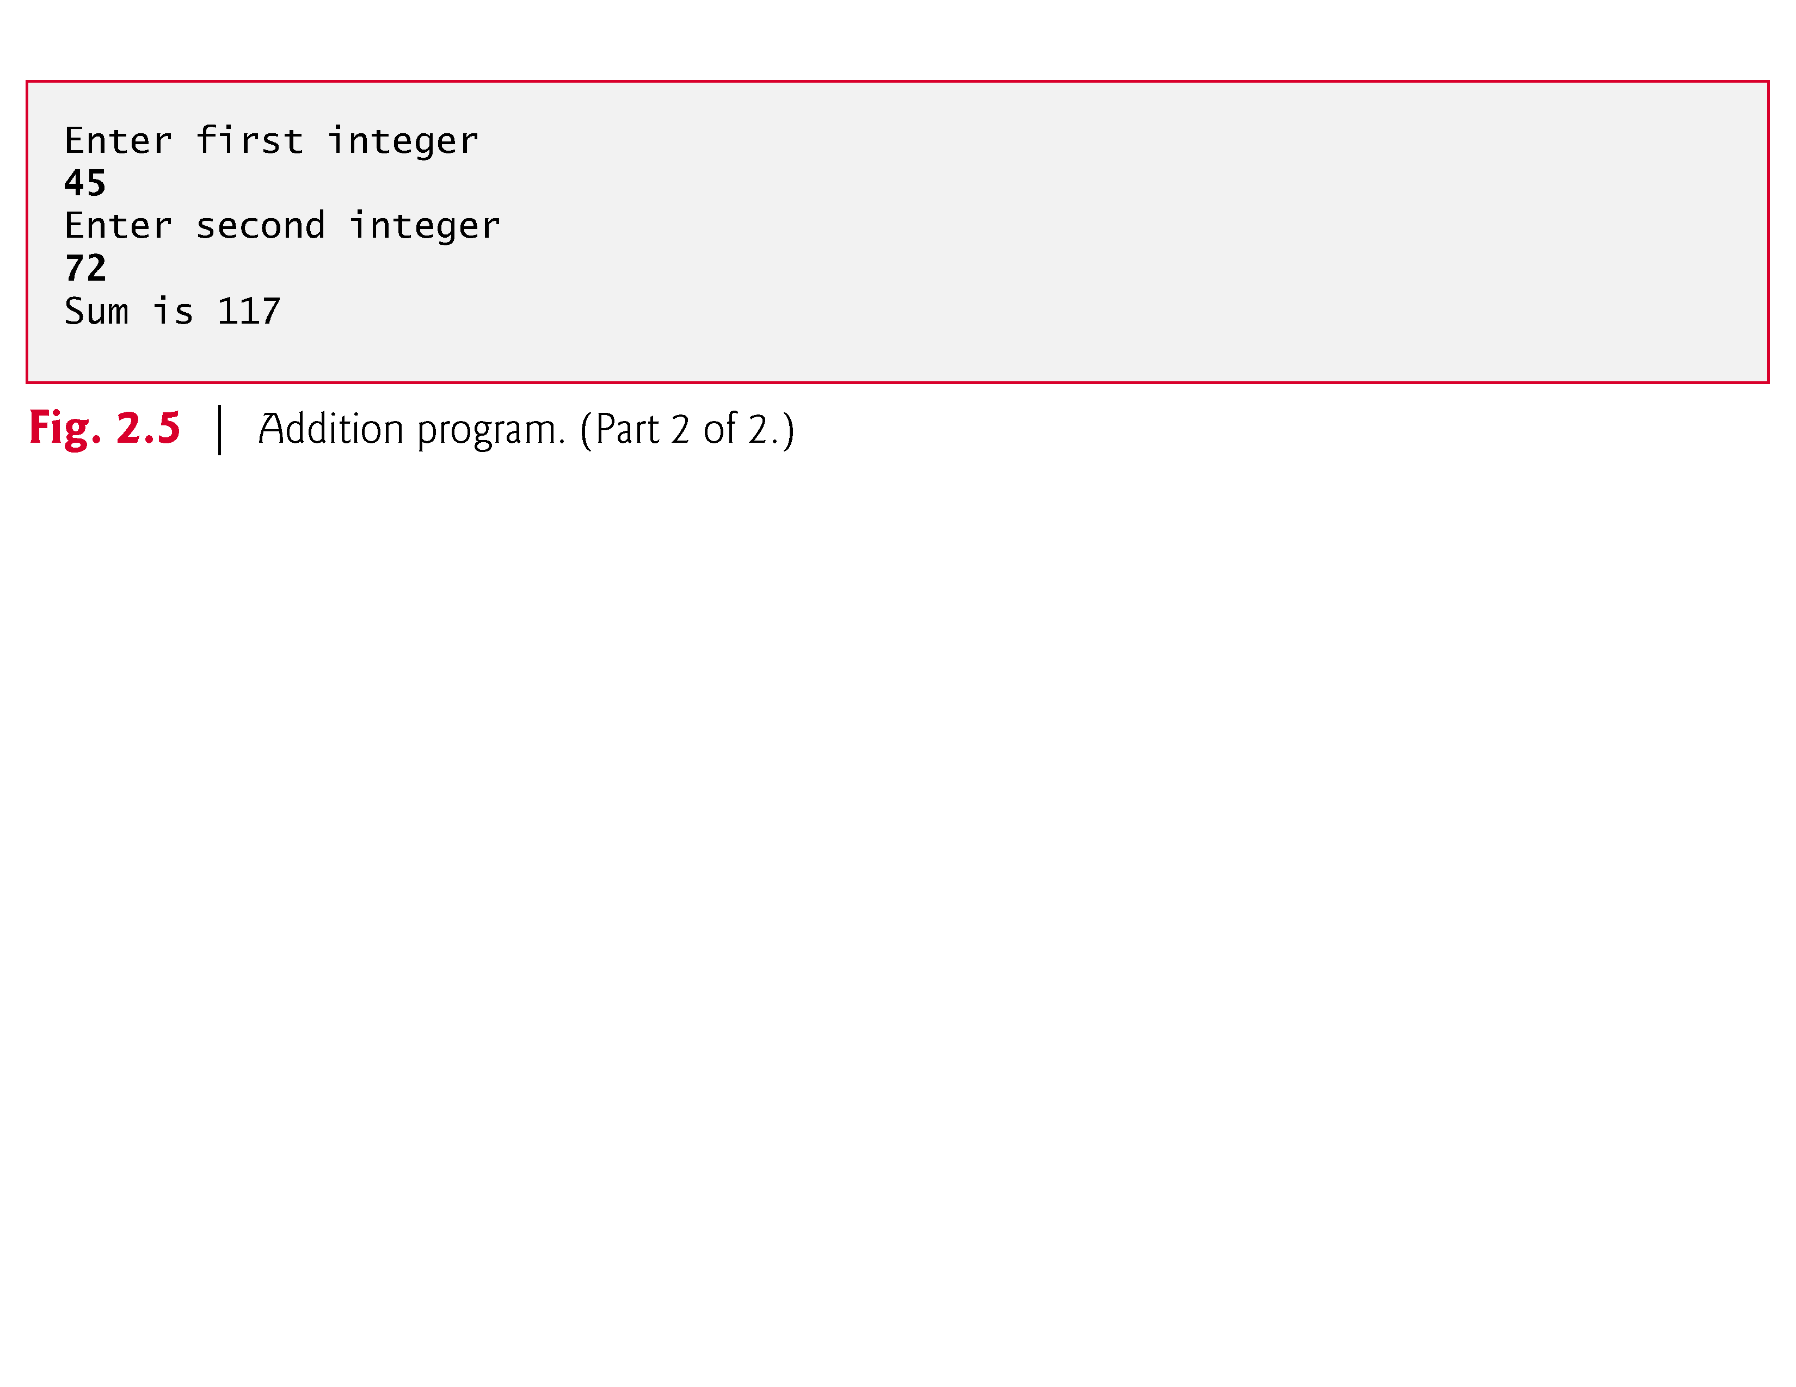

Slide 15
2.3 Another Simple C Program: Adding Two Integers (Cont.)
As before
  Comments, #include <stdio.h> and main
Variables and Variable Definitions
int integer1; // first number to be entered by user
int integer2; // second number to be entered by user
int sum; // variable in which sum will be stored

Slide 16
2.3 Another Simple C Program: Adding Two Integers (Cont.)
The scanf Function and Formatted Inputs
scanf( "%d", &integer1 ); // read an integer
  uses scanf to obtain a value from the user.
The scanf function reads from the standard input, which is usually the keyboard.
This scanf statement has two arguments
    %d - indicates data should be a decimal integer
    &integer1 - location in memory to store variable
    & is confusing in beginning – for now, just remember to include it with the variable name in scanf statements
When executing the program the user responds to the scanf statement by typing in a number, then pressing the enter (return) key

Slide 17
2.3 Another Simple C Program: Adding Two Integers (Cont.)
Assignment Statement
The assignment statement
    sum = integer1 + integer2; // assign total to sum
  calculates the total of variables integer1 and integer2 and assigns the result to variable sum using the assignment operator =.
printf( "Sum is %d\n", sum );
  Similar to scanf
    %d means decimal integer will be printed
    sum specifies what integer will be printed
  Calculations can be performed inside printf statements
    printf( "Sum is %d\n", integer1 + integer2 );

Slide 18
The printf Function
print list
  in a call to printf, the variables or expressions whose values are displayed
placeholder
  a symbol beginning with % in a format string that indicates where to display the output value
printf(“"Sum is %d\n", sum );

Slide 19
Data Types
int
  a whole number
  435
double
  a real number with an integral part and a fractional part separated by a decimal point
  3.14159
char
  an individual character value
  enclosed in single quotes
  ‘A’, ‘z’, ‘2’, ‘9’, ‘*’, ‘!’

Slide 20
Placeholders in format string
Placeholder | Variable Type | Function Use
% c | char | printf/scanf
% d | int | printf/scanf
% f | double | printf
% lf | double | scanf

Slide 21
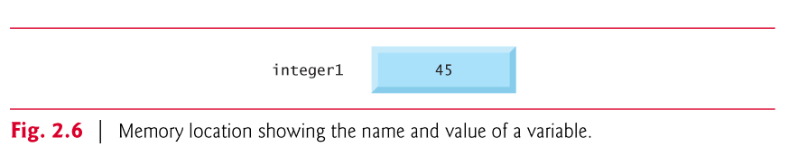
2.4 Memory Concepts
Variables
  Variable names such as integer1, integer2 and sum actually correspond to locations in the computer’s memory.
  Every variable has a name, a type and a value.
  In the addition program of Fig. 2.5, when the statement
    scanf( "%d", &integer1 ); // read an integer
  is executed, the value entered by the user is placed into a memory location to which the name integer1 has been assigned.
Suppose the user enters the number 45 as the value for integer1.
The computer will place 45 into location integer1 as shown in Fig. 2.6.

Slide 22
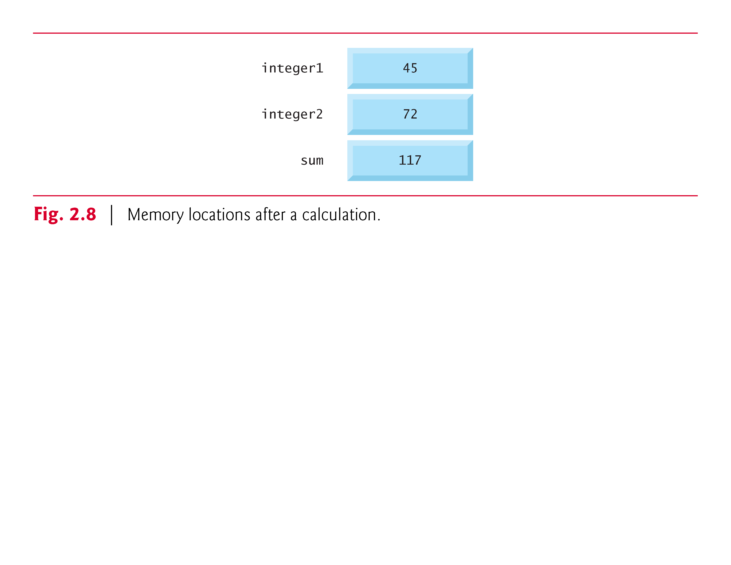

Slide 23
2.5 Arithmetic in C
Arithmetic calculations (+, -, *, /, %)
  The asterisk (*) indicates multiplication and the percent sign (%) denotes the remainder operator.
Integer Division
  Integer division yields an integer result
  For example, the expression 7 / 4 evaluates to 1 and the expression 17 / 5 evaluates to 3
Remainder operator %
  Modulus operator (%) returns the remainder
  7 % 4 yields 3 and 17 % 5 yields 2.

Slide 24
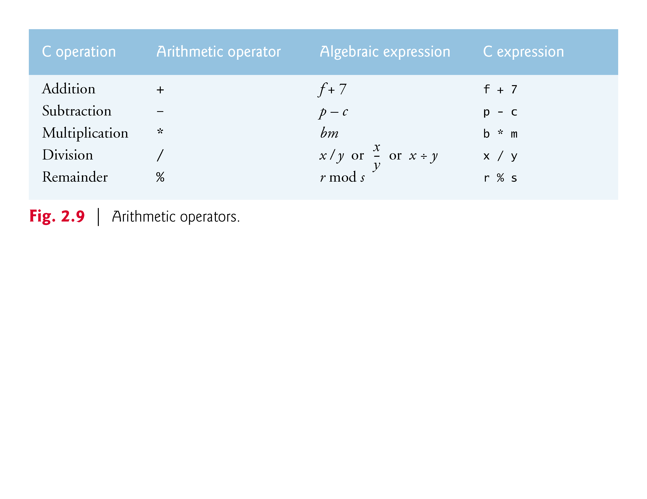
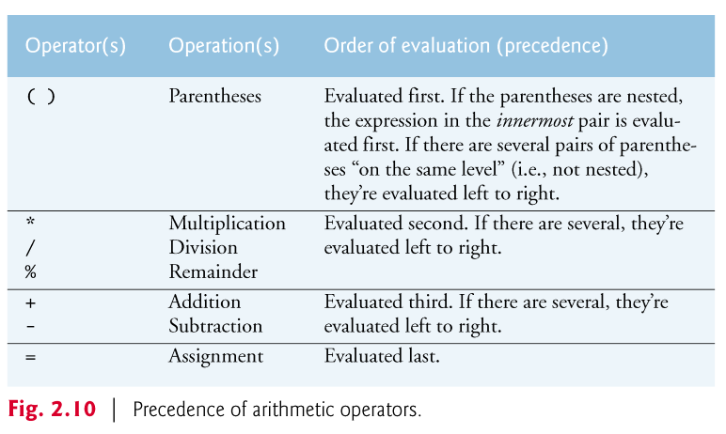

Slide 25
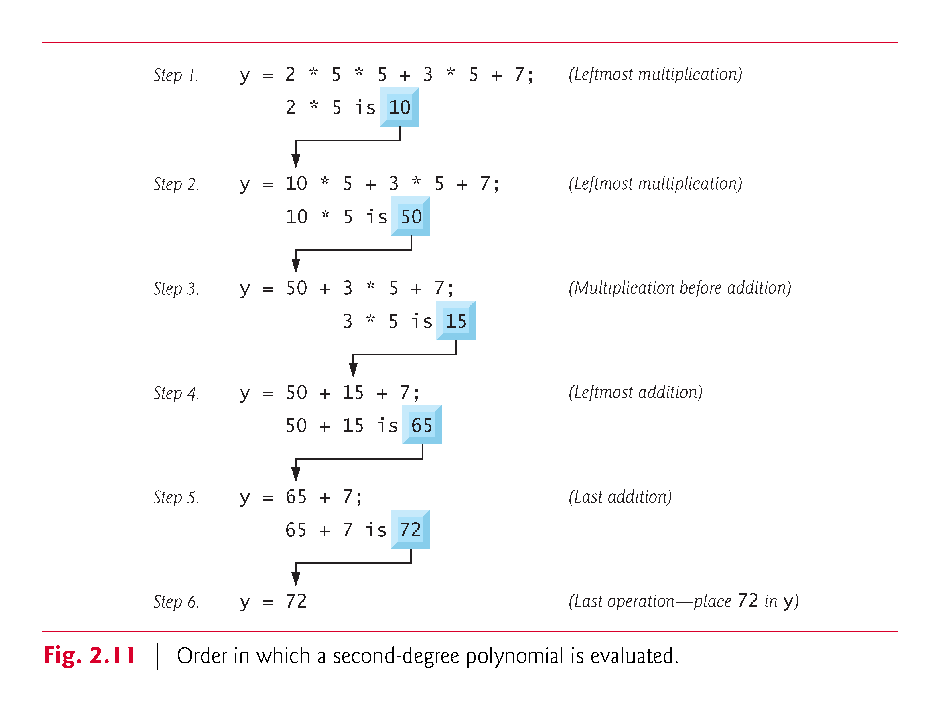

Slide 26
2.6 Decision Making: Equality and Relational Operators
Executable C statements
  perform actions (such as calculations or input or output of data)
  make decisions
    May want to print "pass" or "fail" given the value of a test grade
if statement
  allows a program to make a decision based on the truth or falsity of a statement of fact called a condition.
  0 is false, non-zero is true

Slide 27
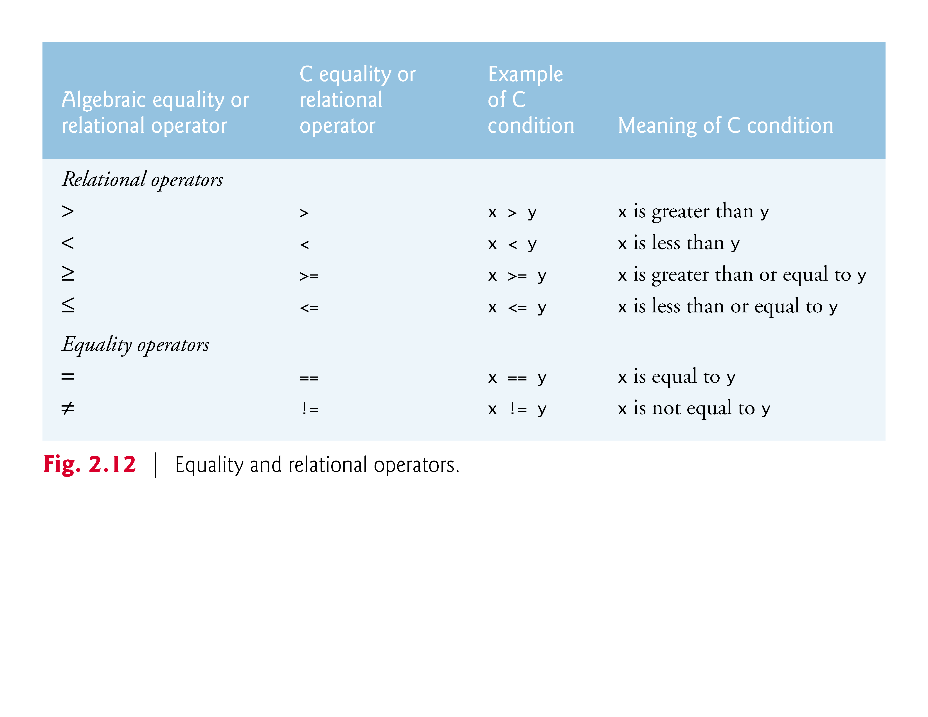

Slide 28
2.6 Decision Making: Equality and Relational Operators
Figure 2.13 uses six if statements to compare two numbers entered by the user.
If the condition in any of these if statements is true, the printf statement associated with that if executes.

Slide 29
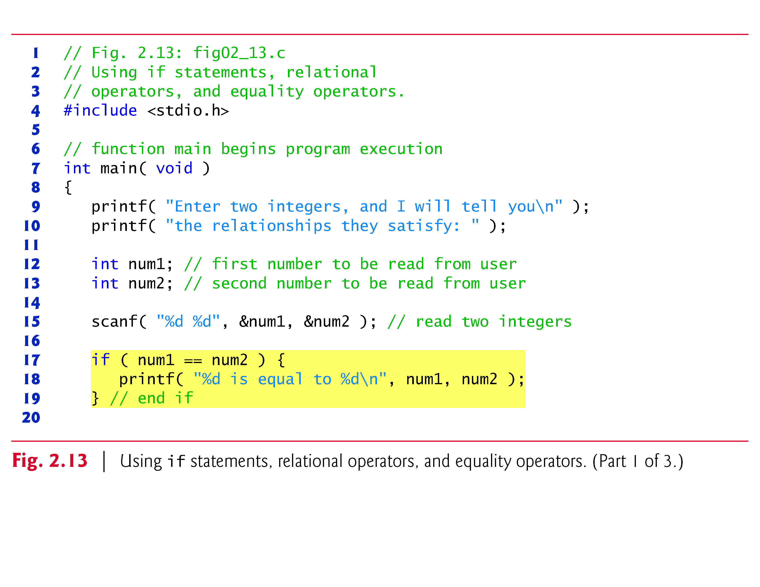
[1] C How to Program 8th Edition, by Deitel & Deitel.

Slide 30
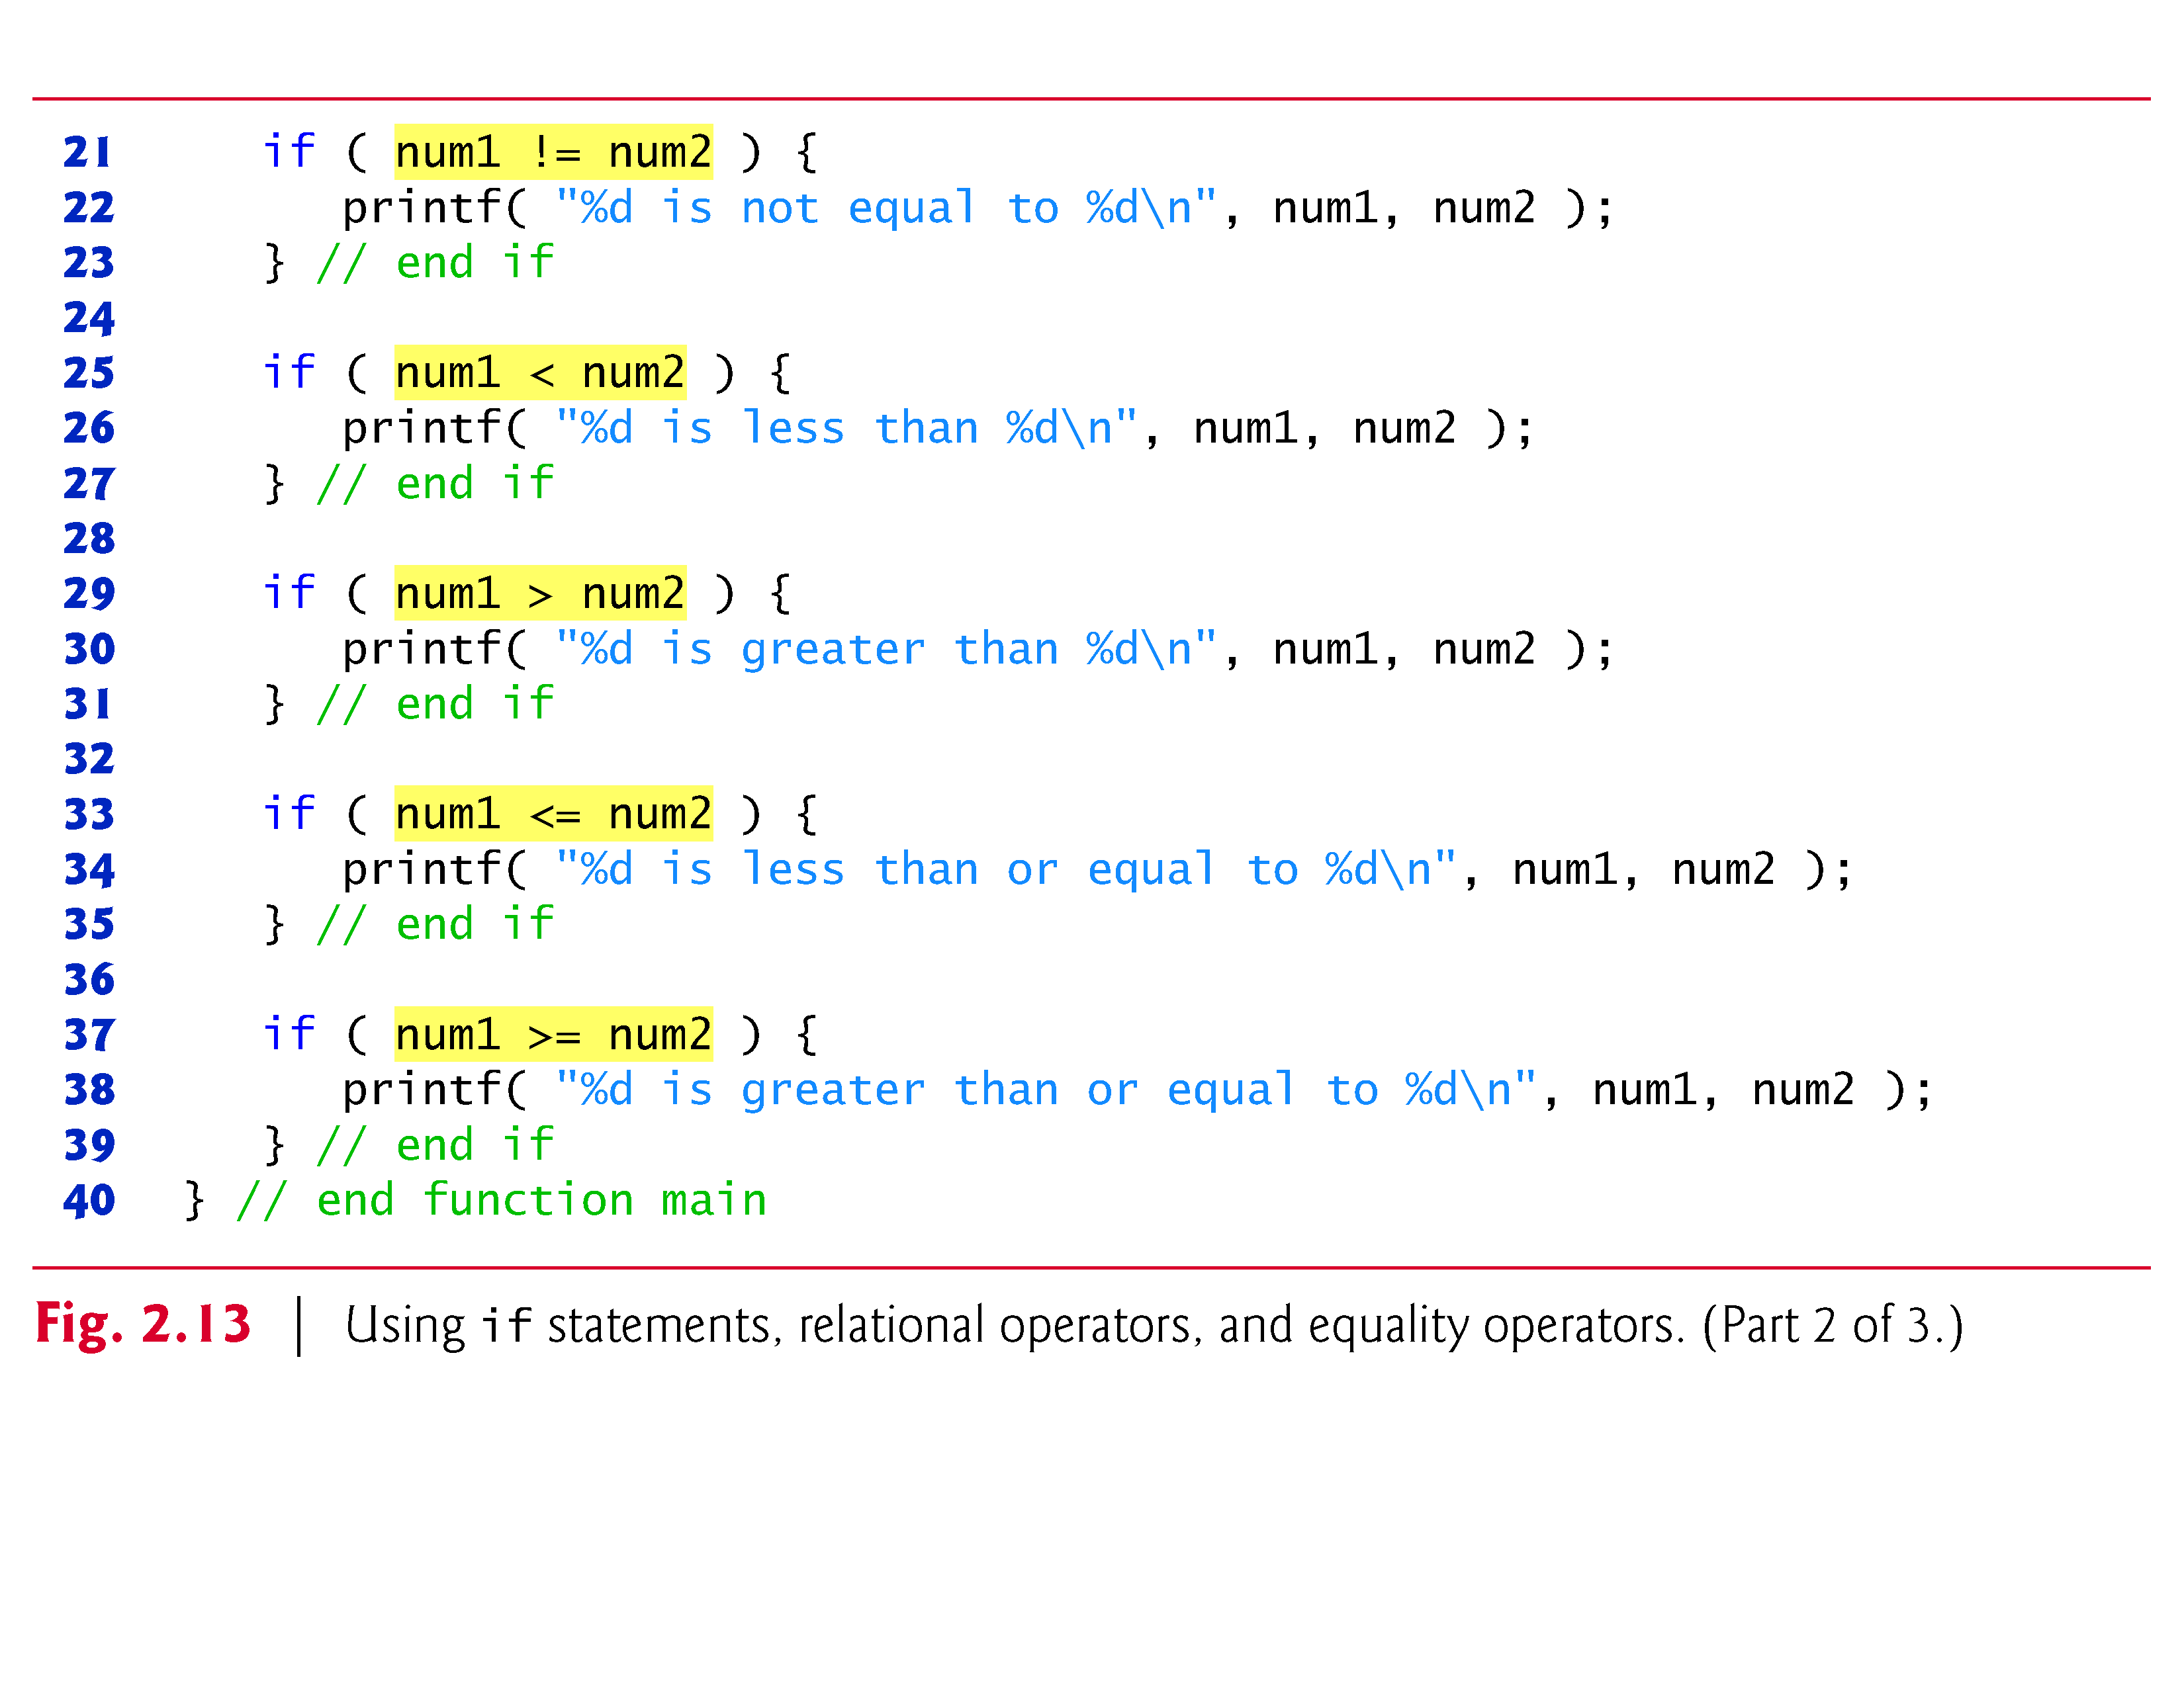

Slide 31
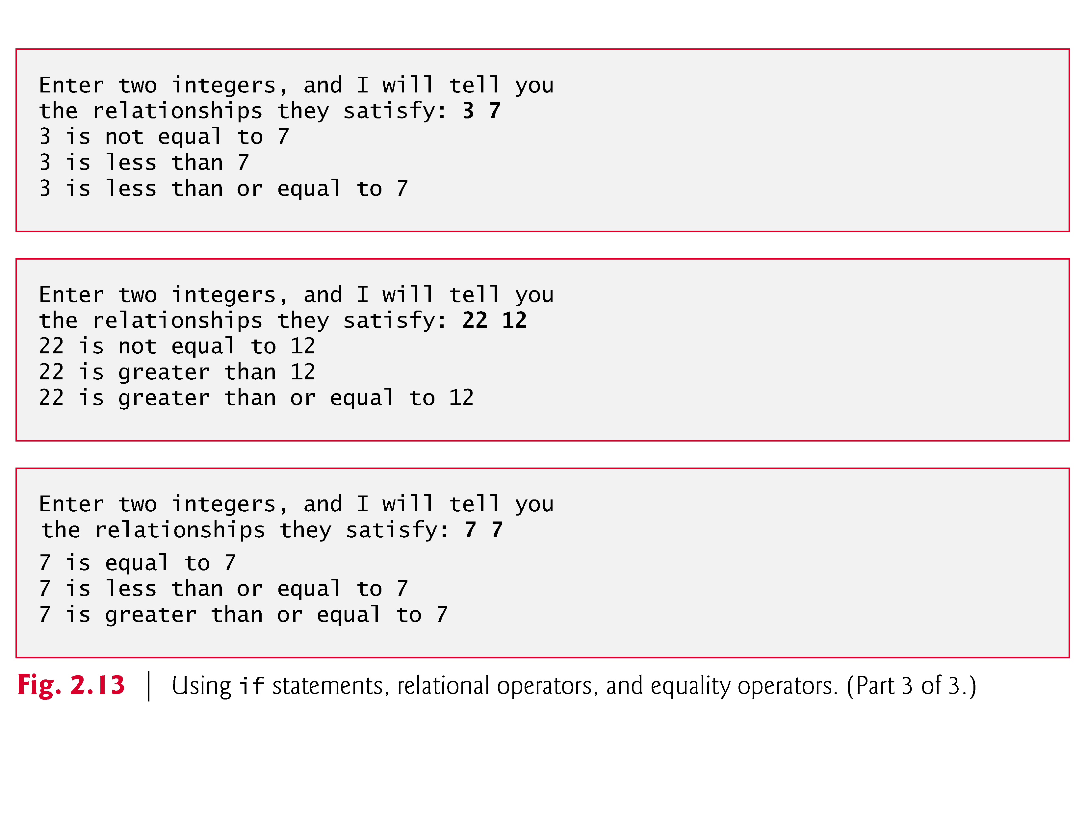

Slide 32
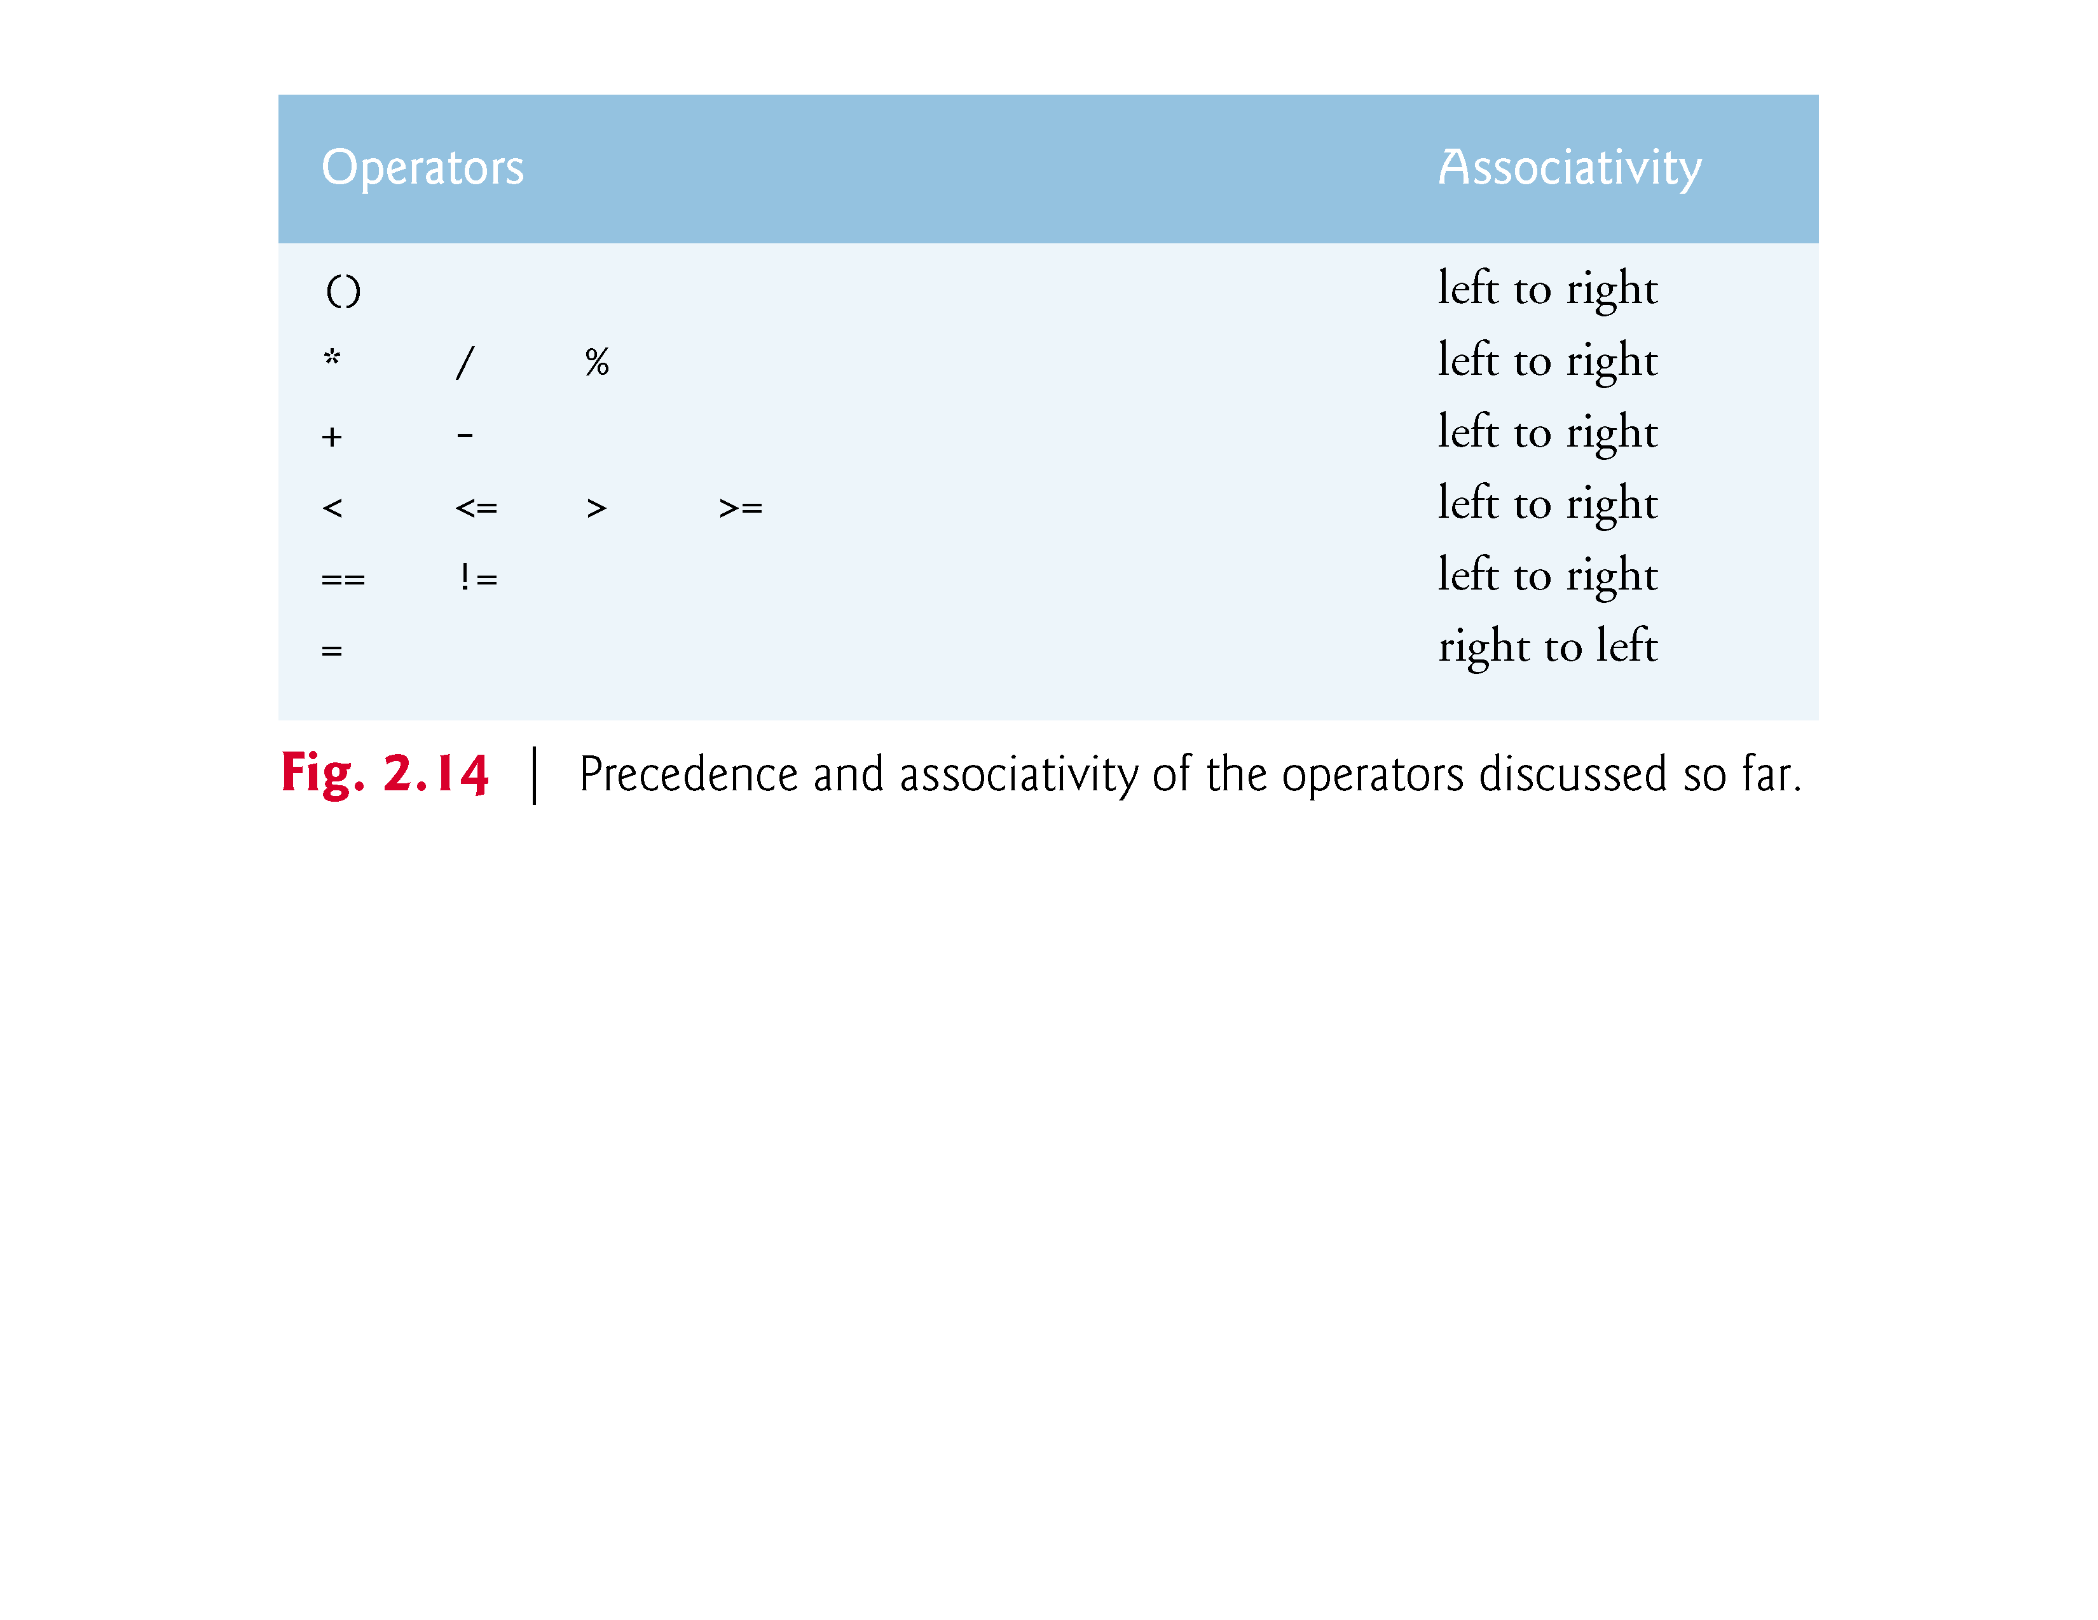

Slide 33
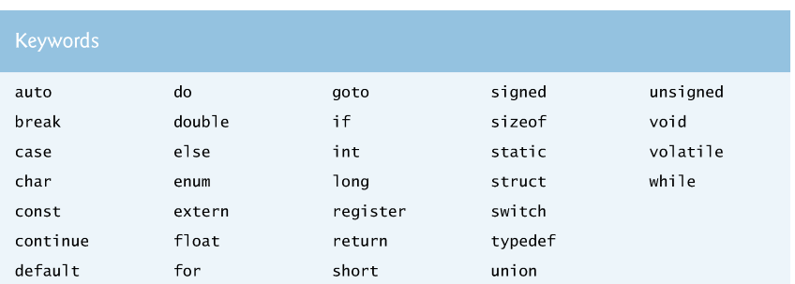
2.6 Decision Making: Equality and Relational Operators
Some of the words we’ve used in the C programs in this chapter—in particular int and if—are keywords or reserved words of the language.
These words have special meaning to the C compiler, so you must be careful not to use these as identifiers such as variable names.

Slide 34
Common Programming Errors
syntax error
  a violation of the C grammar rules
  detected during program translation (compilation)
run-time error
  an attempt to perform an invalid operation
  detected during program execution
logic errors
  an error caused by following an incorrect algorithm

Slide 35
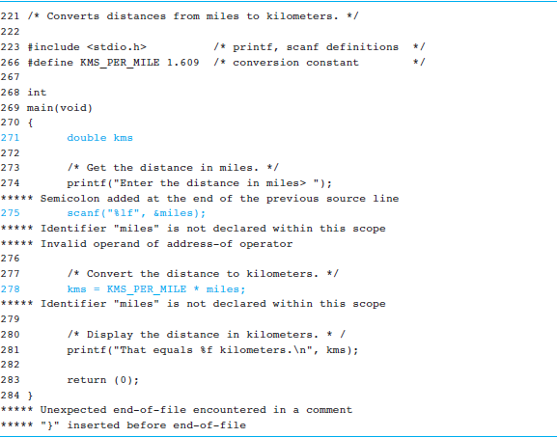
Figure 2.16
Compiler Listing of a Program with Syntax Errors
[2] Problem Solving & Program Design in C, Eighth Edition, R. Hanly & Elliot B. Koffman.

Slide 36
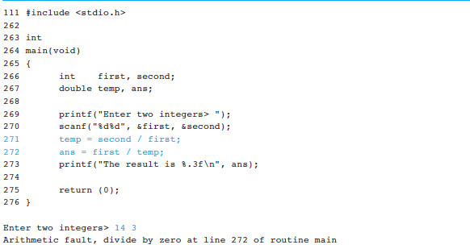
Figure 2.17
A Program with a Run-Time Error
[2] Problem Solving & Program Design in C, Eighth Edition, R. Hanly & Elliot B. Koffman.

Slide 37
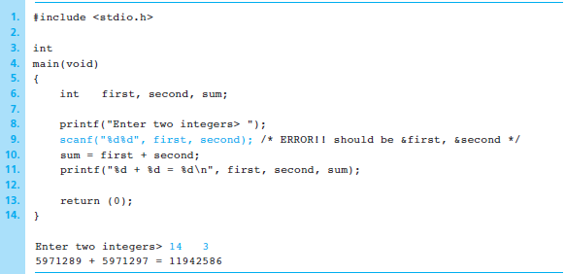
Figure 2.19
A Program That Produces Incorrect Results Due to Omission
[2] Problem Solving & Program Design in C, Eighth Edition, R. Hanly & Elliot B. Koffman.

Slide 38
Wrap Up
Every C program has preprocessor directives and a main function.
The main function contains variable declarations and executable statements.
C’s data types enable the compiler to determine how to store a value in memory and what operations can be performed on that value.

